Slide 1
Lapps Service Wrapping
Lapps Grid Group
May 26, 2014

Slide 2
Outline
Overview
From Software to Web Service
From NLP Tool to Lapps Service
Java Example
Python Example
Conclusion
Reference

Slide 3
The Language Application Grid
Availability & Interoperability of NLP Tools
Java, Python, tools
OpenNLP, Stanford NLP, Gate, NLTK
Language Application (Lapps) Grid Project
Language Service
Lapps API Design

Slide 4
Lapps Grid Architecture

Slide 5
Lapps API Design
Unique Interface
Discriminator
JSON Format

Slide 6
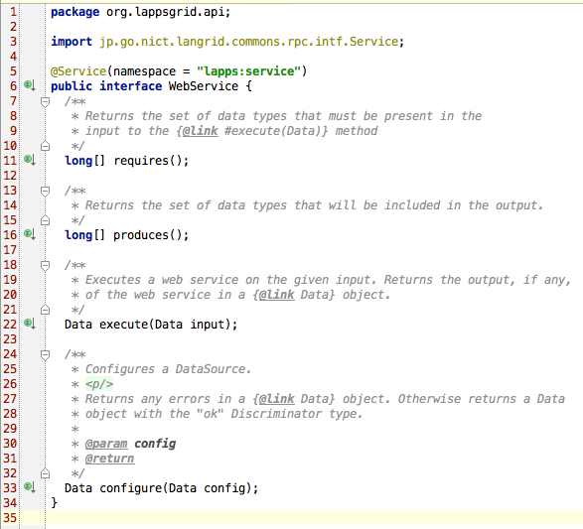
Interface (Java)

Slide 7
Lapps Service Wrapping
Service Grid (Web Service) and Service Manager
Java Library to WSDL Web Service
Service Manager for Register Web Services
Lapps Service
NLP library + Lapps API to Lapps Service
Lapps Grid for Register Lapps Service

Slide 8
Service Wrapping Tutorial
Web Service: “Hello World!”
“Hello World” Program (Java) —> WSDL
Lapps Service: “Stanford Tagger”
Stanford Tagger (Java) + Lapps API —> WSDL
Lapps Service: “NLTK Tagger”
NLTK Tagger (Python) + Lapps API —>WSDL

Slide 9
Web Service Wrapping

Slide 10
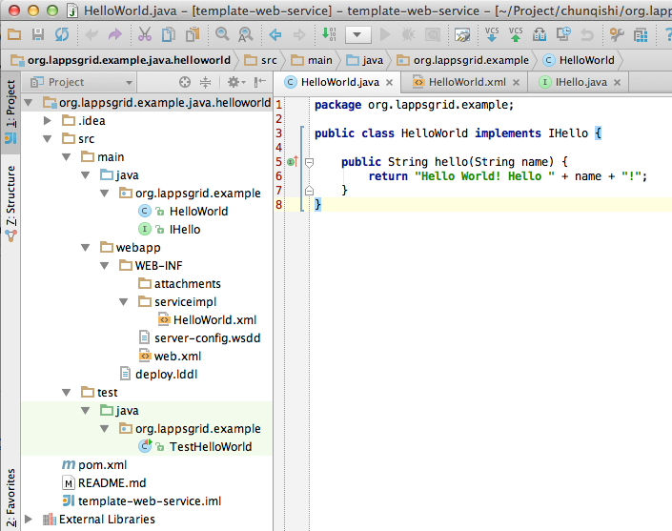
Hello World (Java)
https://github.com/chunqishi/org.lappsgrid.example.java.helloworld

Slide 11
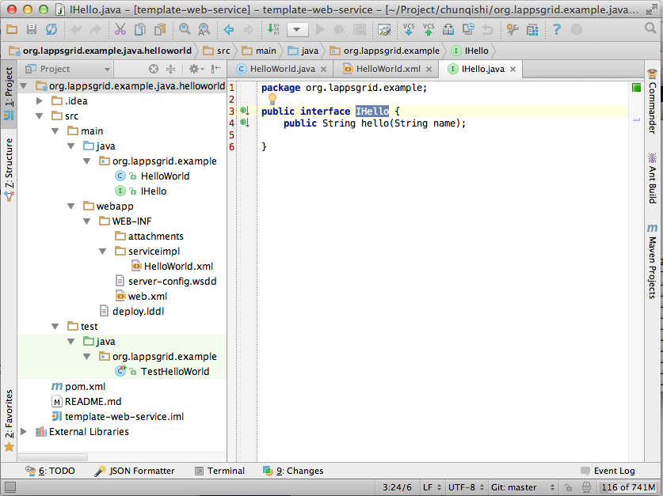
Interface Design

Slide 12
Developing Template
Developing Template
Maven for Dependency Library Management
Github Repository
https://github.com/chunqishi/org.lappsgrid.example.java.helloworld
Local Test
Maven Compile/Package & Jetty Server based Testing
Command: mvn clean package jetty:run

Slide 13
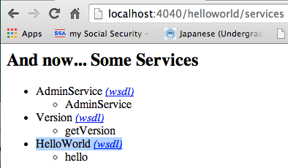
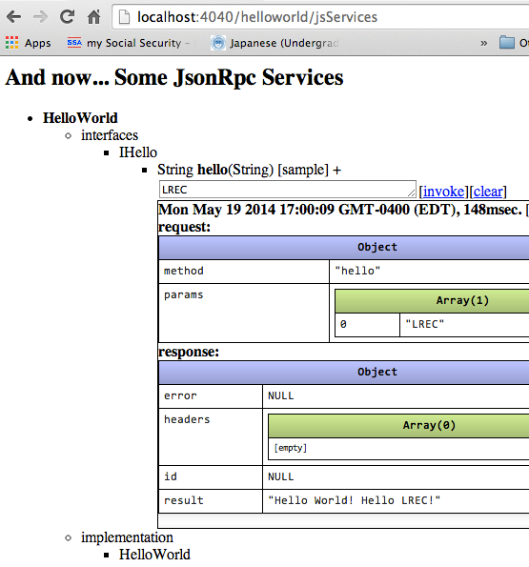
Web Service WSDL

Slide 14
Lapps Service Wrapping (Java)

Slide 15
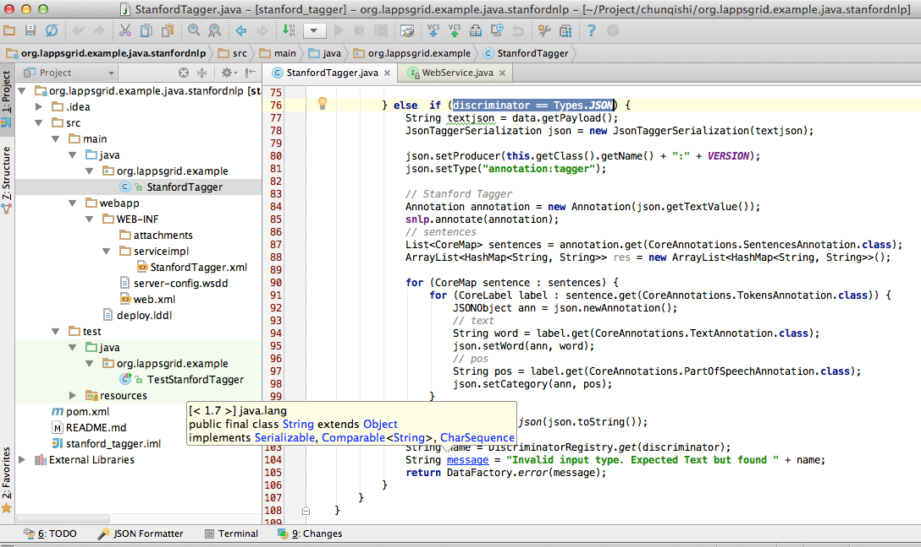
Developing Template
https://github.com/chunqishi/org.lappsgrid.example.java.stanfordnlp

Slide 16
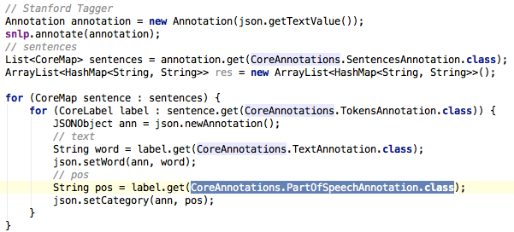
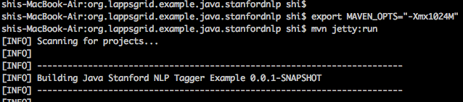
Stanford Tagger Wrapping
Java Wrapping
Jetty Running

Slide 17
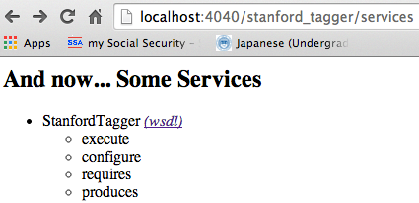
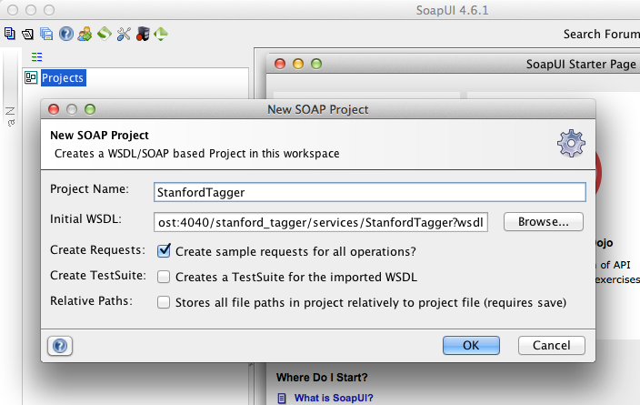
Stanford Tagger Testing
Local Service
SoapUI Testing

Slide 18
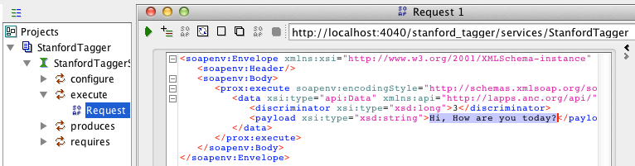
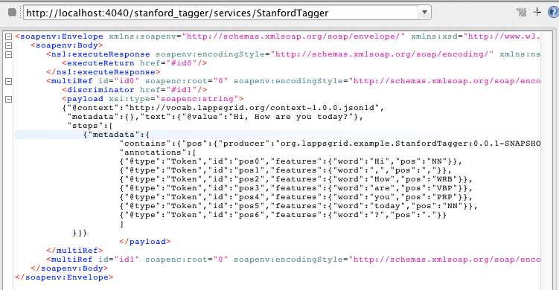
Stanford Tagger Testing Result
Request
Response

Slide 19
Lapps Service Wrapping (Python)

Slide 20
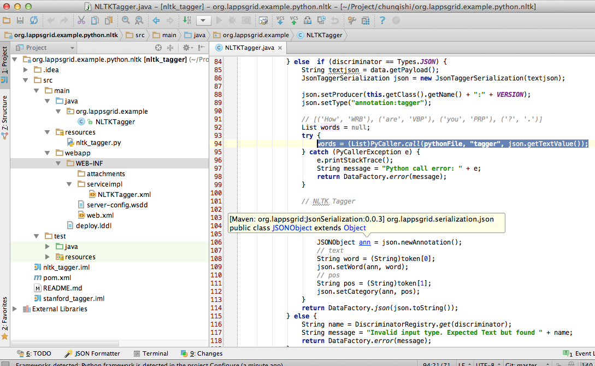

Developing Template

Slide 21
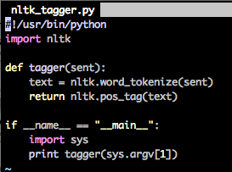
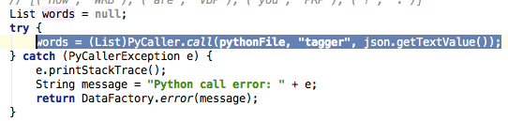
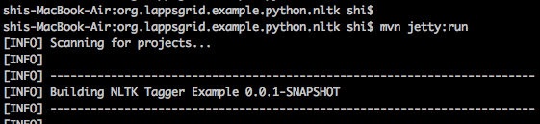
NLTK Python
Python Program
Python Result
Java Wrapping
Jetty Running

Slide 22
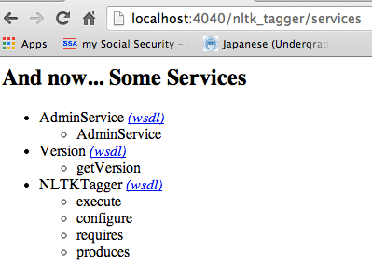
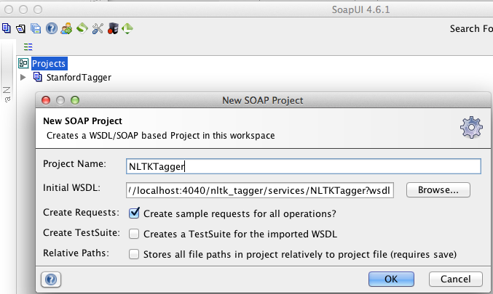
NLTK Tagger Testing
Local Service
SoapUI Testing

Slide 23
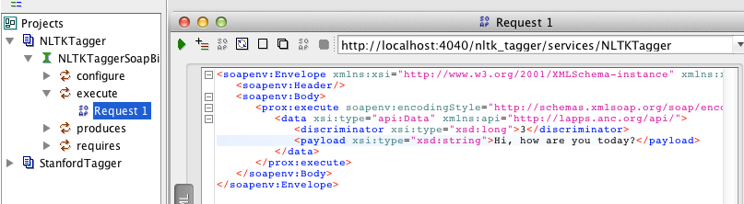
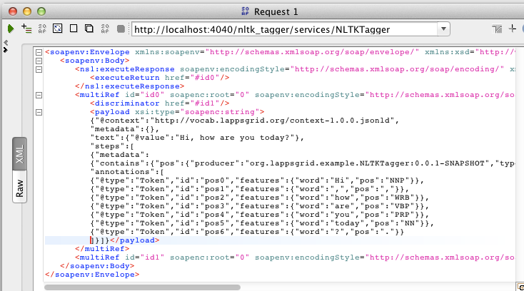
NLTK Tagger Testing Result
Request
Response

Slide 24
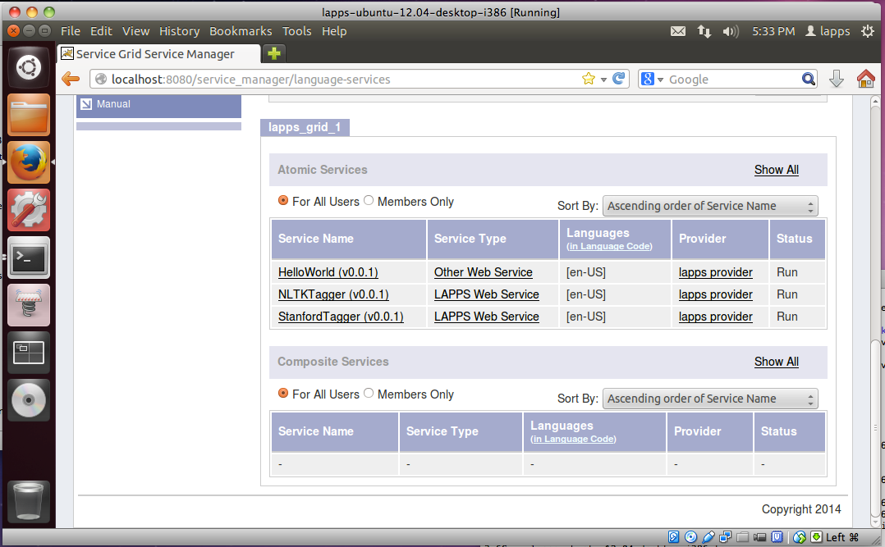
Service Register
Service Manager

Slide 25
Conclusion
Lapps Service Wrapping Template
Java / Python Wrapping
Github Repository
Service Manager for Registering
Service Manager Installation Script
Developing Environment
VirtualBox Image: Ubuntu

Slide 26
Reference

